Slide 1
Allegro Differential Line Routing
2016/02/03
Cheng-Yung Ke
Advisor: Dr. Yu-Jiu Wang
RFVLSI LAB, NCTU

Slide 2
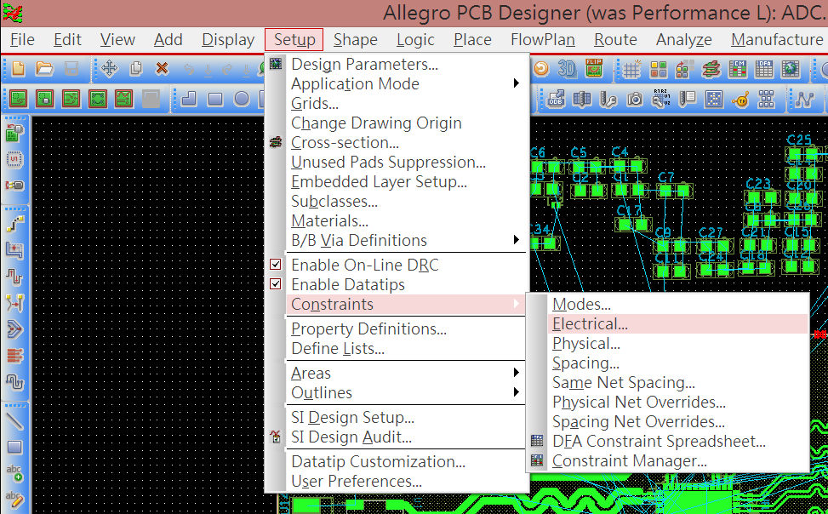
Define Differential Pair
Use the constraints manager

Slide 3
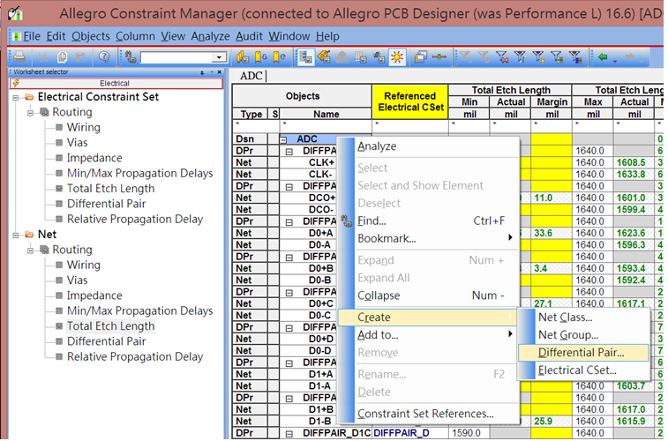
Define Differential Pair
Follow the step to create differential Pair

Slide 4
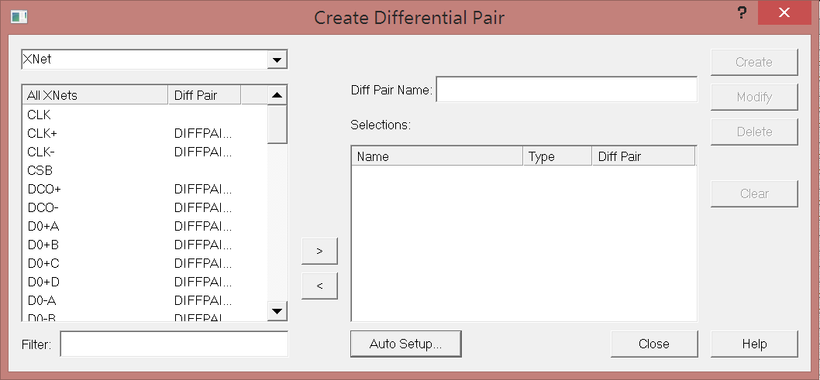
Define Differential Pair
Use the auto setup function

Slide 5
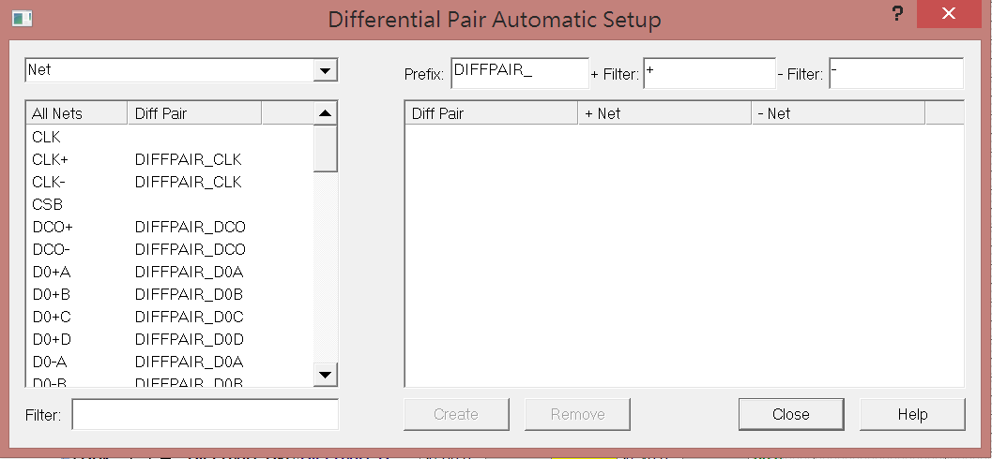
Define Differential Pair
Create differential pair using the filter function

Slide 6
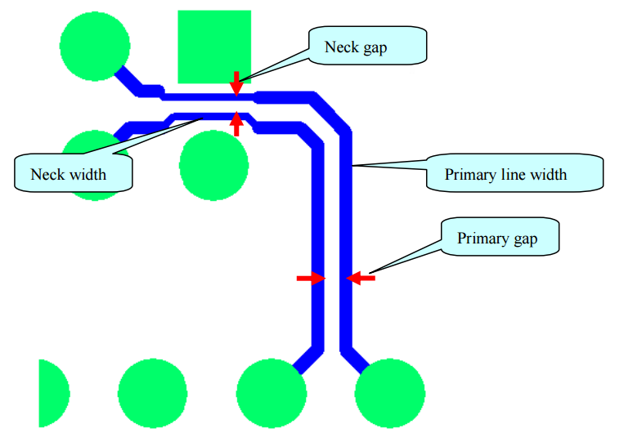
Define Differential Pair
Differential Pair In Allegro

Slide 7
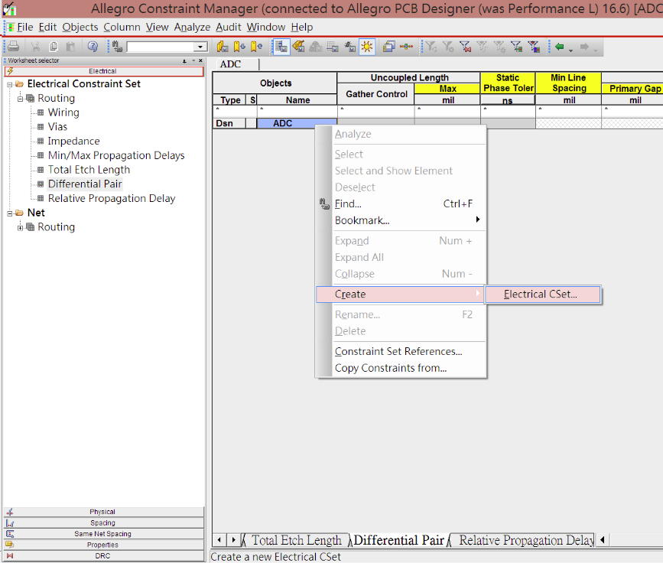
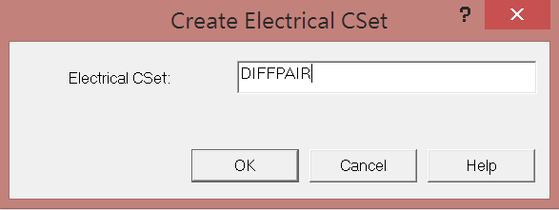
Define Differential Pair
Create Electrical CSet

Slide 8
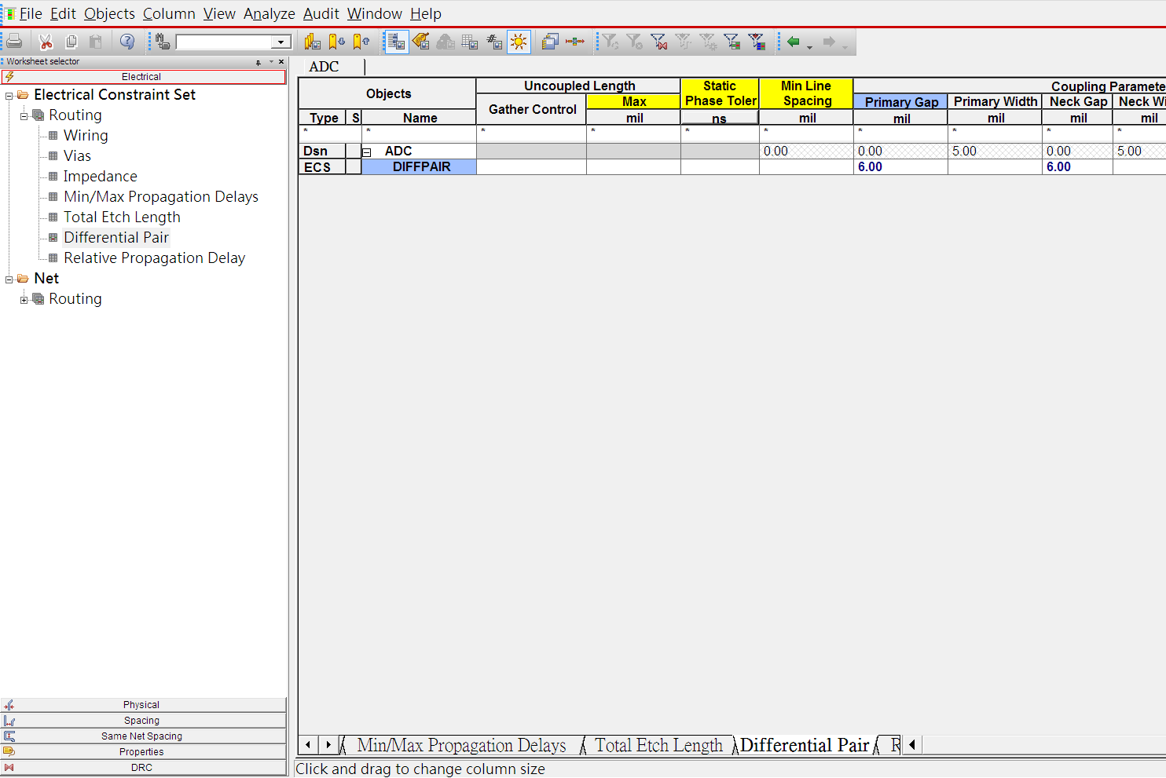
Define Differential Pair
Setting the rules of differential line

Slide 9
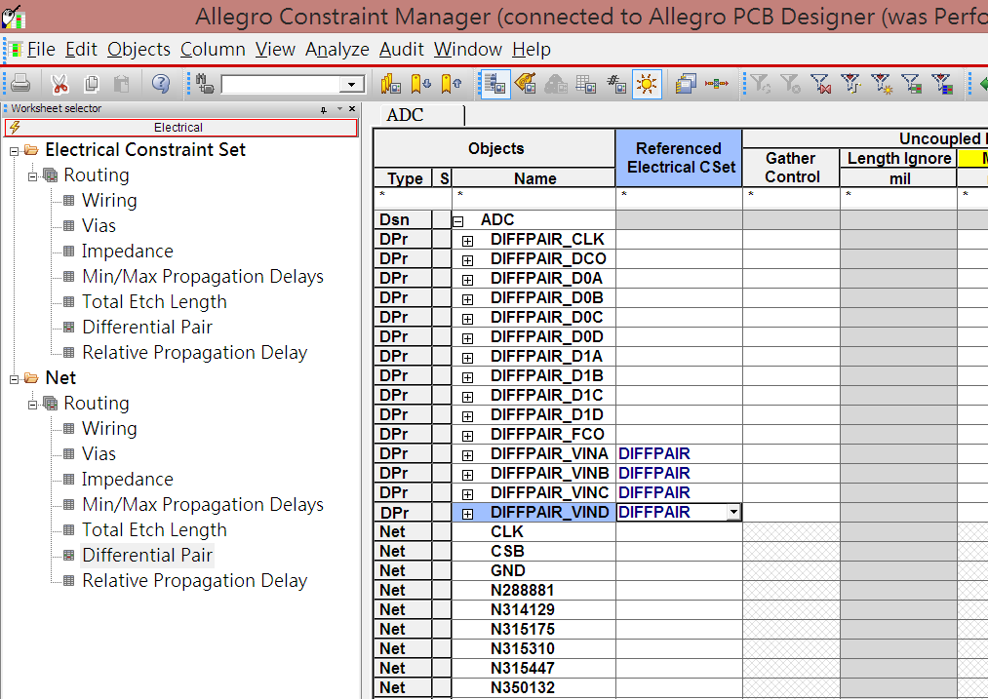
Define Differential Pair
Set up the Referenced Electrical CSet

Slide 10
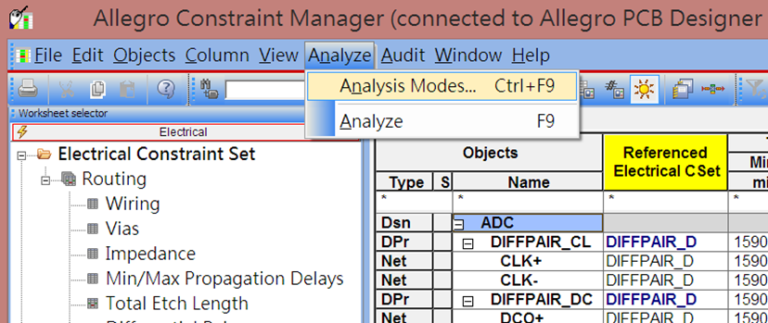
Length Analysis
Setting analysis modes

Slide 11
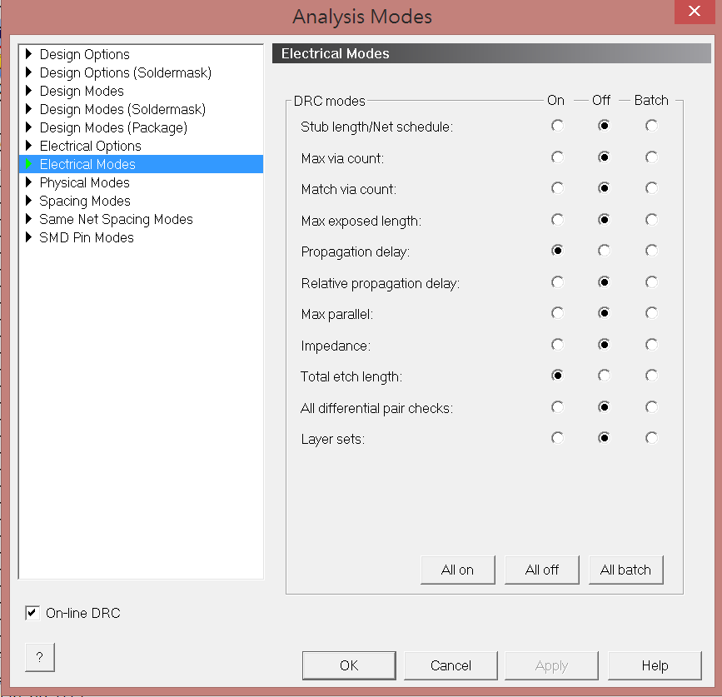
Length Analysis
Turn the option of total etch length ON

Slide 12
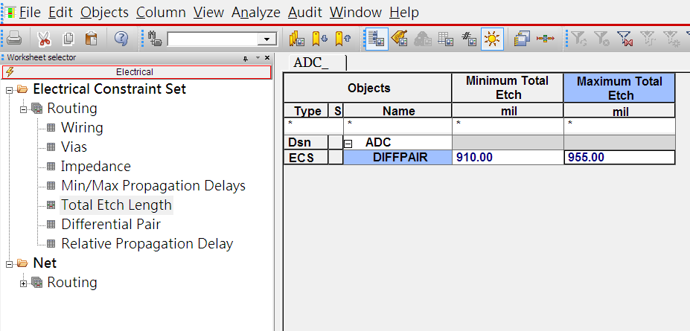
Length Analysis
Set up the range of total etch length.

Slide 13
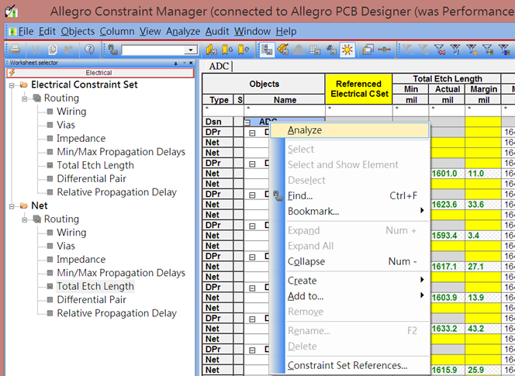
Length Analysis
Do the analysis

Slide 14
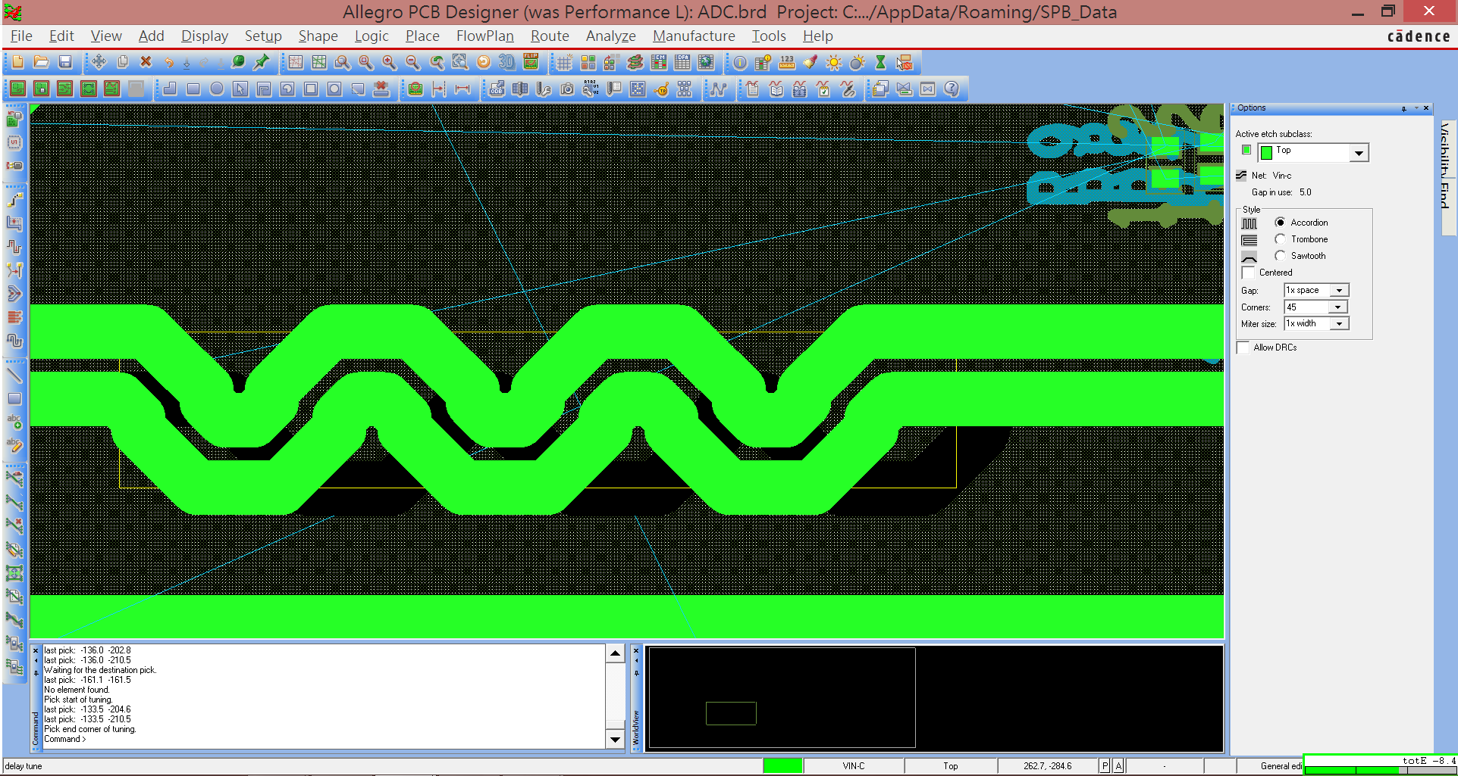
Length Analysis
Delay tune function
Use the delay tune function to make total length of each differential pair in the range you set in the electrical constraint set.

